Slide 1
FACE DETECTION

Slide 2

FACE DETECTION
PREVENT RETAIL CRIME :
Face recognition is currently being used to instantly identify when known shoplifters, organized retail criminals or people with a history of fraud enter retail establishments.
UNLOCK PHONES :
A variety of phones including the latest iPhone, Samsung, mi are now using face recognition to unlock phones.
FIND MISSING PERSONS :
Face recognition can be used to find missing children and victims of human trafficking.
Autonomous driving
Companies are really investing into autonomous driving which involves lane and person tracking and recognition.

Slide 3
FACE DETECTION
IDENTIFY PEOPLE ON SOCIAL MEDIA PLATFORMS
Facebook uses face recognition technology to automatically recognize when facebook members appear in photos.
RECOGNIZE VIPS AT SPORTING EVENTS
Face recognition can be used to provide fans with a better experience.
PROTECT SCHOOLS FROM THREATS
Face recognition surveillance systems can instantly identify when expelled students, dangerous parents, drug dealers or other individuals that pose a threat to school safety enter school grounds.
TRACK SCHOOL ATTENDANCE
In addition to making schools safer, face recognition has the potential to track students’ attendance.

Slide 4
FACE DETECTION
CASINOS
Face recognition can help casinos recognize the moment that a cheater or advantage gambler enters a casino
VALIDATE IDENTITY AT ATMS :
It seems likely that face scans will eventually replace ATM cards completely since face recognition is such a powerful identity authentication tool
MAKE AIR TRAVEL MORE CONVENIENT
Airlines have already started using face recognition to help people check bags, check into flights and board planes faster
RECOGNIZE DRIVERS
More car companies are experimenting with ways to use face recognition. One use of face recognition for automobiles is using a face to replace a key as a means of starting a car.

Slide 5
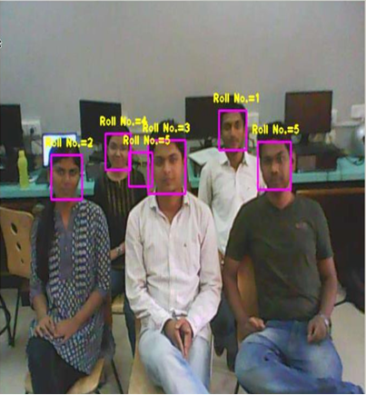

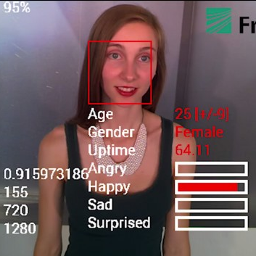
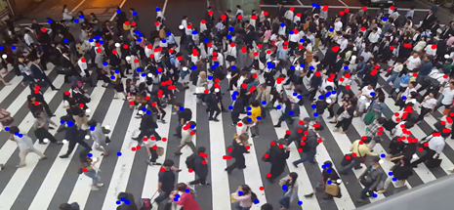
Examples

Slide 6
Steps
face_cascade = cv2.CascadeClassifier('haarcascade_frontalface_default.xml')
cap = cv2.VideoCapture(0)
Img = cap.read()
gray = cv2.cvtColor(img, cv2.COLOR_BGR2GRAY)
faces = face_cascade.detectMultiScale(gray, 1.1, 4)
for (x, y, w, h) in faces:
cv2.rectangle(img, (x, y), (x+w, y+h), (255, 0, 0), 2)

Slide 7
Cascade Classifier
Model was trained with best classifies the face and non-face images and 160000+ features were pulled out and after applying ADABOOST there was reduction from 160000+ features to 6000 features.
Instead of applying all the 6000 features on a window, group the features into different stages of classifiers and apply one-by-one. (Normally first few stages will contain very a smaller number of features). If a window fails the first stage, discard it. We don’t consider remaining features on it. If it passes, apply the second stage of features and continue the process. The window which passes all stages is a face region

Slide 8
detectMultiScale()
We use v2.CascadeClassifier.detectMultiScale() to find faces or eyes, and it is defined like this:
cv2.CascadeClassifier.detectMultiScale(image, scaleFactor, minNeighbors)
Where the parameters are:
image : Matrix of the type CV_8U containing an image where objects are detected.
scaleFactor : Parameter specifying how much the image size is reduced at each image scale.
minNeighbors : Parameter specifying how many neighbors each candidate rectangle should have to retain it. This parameter will affect the quality of the detected faces: higher value results in less detections but with higher quality. We're using 5 in the code.
If faces are found, it returns the positions of detected faces as Rect(x,y,w,h).
faces = face_cascade.detectMultiScale(gray, 1.3, 5)

Slide 9

Thank You
ASHISH.GP10@GMAIL.COM
https://www.linkedin.com/in/ashish-gupta-405b1b47/
7022450444

